Slide 1
Vulcan Defect Status
May. 02, 2016
Tao Wu, Wen Yi Gao

Slide 2
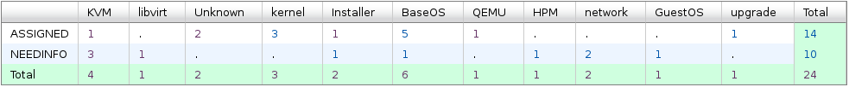
Vulcan - Open Defects
24 open defects excluding 5 HVM bugs.
8 defects new opened in the last two weeks. We solved 12 defects in the past two weeks.
Defect statistics:

Slide 3
Vulcan – High Priority Defects
No | ID | Pri | Sev | Comp | Summary | Status | Comment
1 | 139984 | P1 | High | KVM | Guests hang when attempting to reboot on Vulcan FP1 | ASSIGNED | - BZ is being cloned to MCP to request a test package.
2 | 136145 | P1 | High | upgrade | Customer is not able to install a Fixpack on a system with SDK installed | ASSIGNED | - Under investigation.
3 | 139772 | P1 | High | BaseOS | chmem -d crashes a Vulcan FP1 system running in a DPM LPAR | ASSIGNED | - Waiting for the reporter to verify the test package.

Slide 4
Vulcan – All Defects
443 defects excluding 117 HVM defects opened in the Vulcan Bugzilla until now.

